Slide 1
Analysis and Prediction Model of Global Pandemic: COVID-19
Anyu Zhu
zhu00428@umn.edu

Slide 2
Visualization and Data Insight
Development of Deep Learning Model for Prediction
Some Thoughts

Slide 3
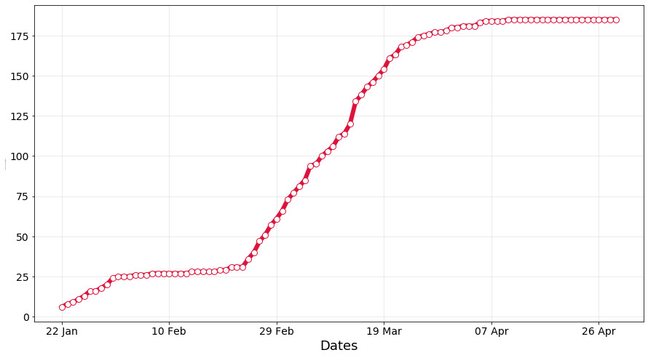
Number of Countries Affected
212 countries and territories
364 million + confirmed cases

Slide 4
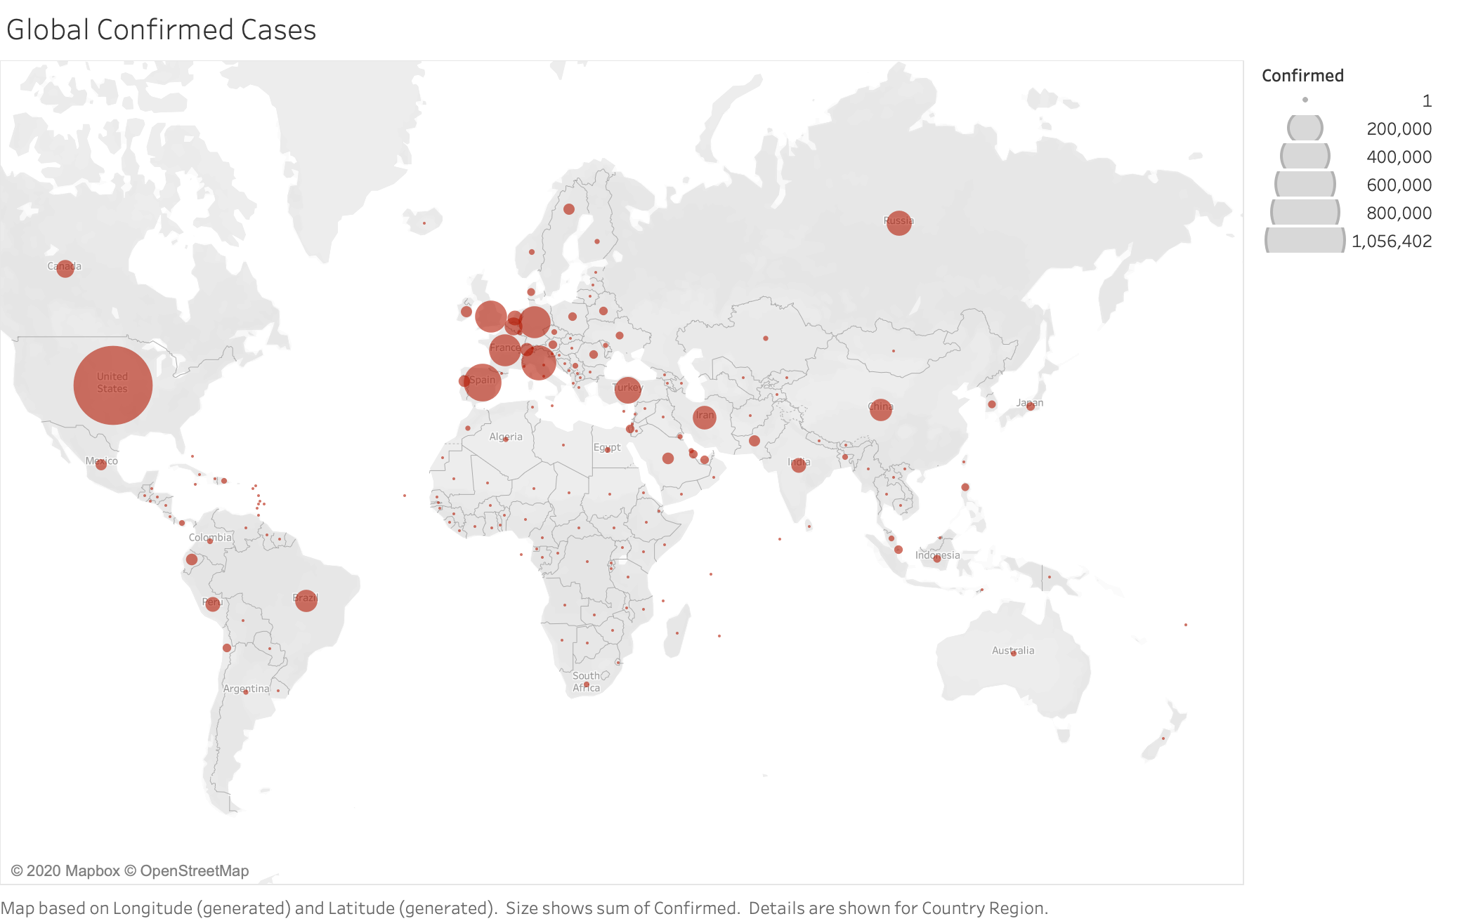
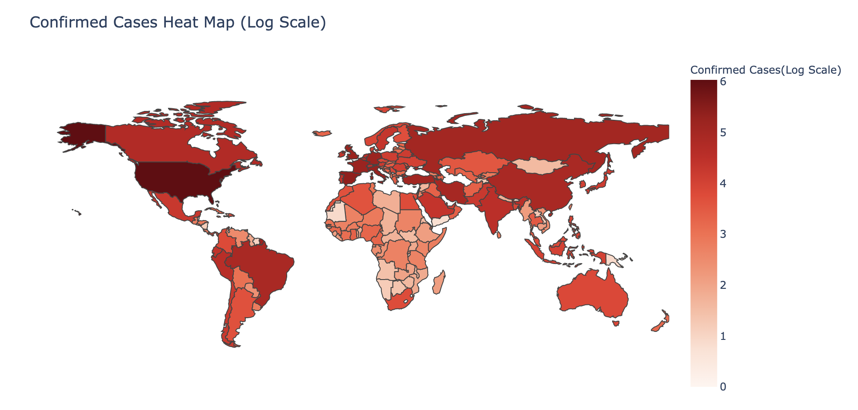
Global Confirmed Cases (By April 30th )

Slide 5
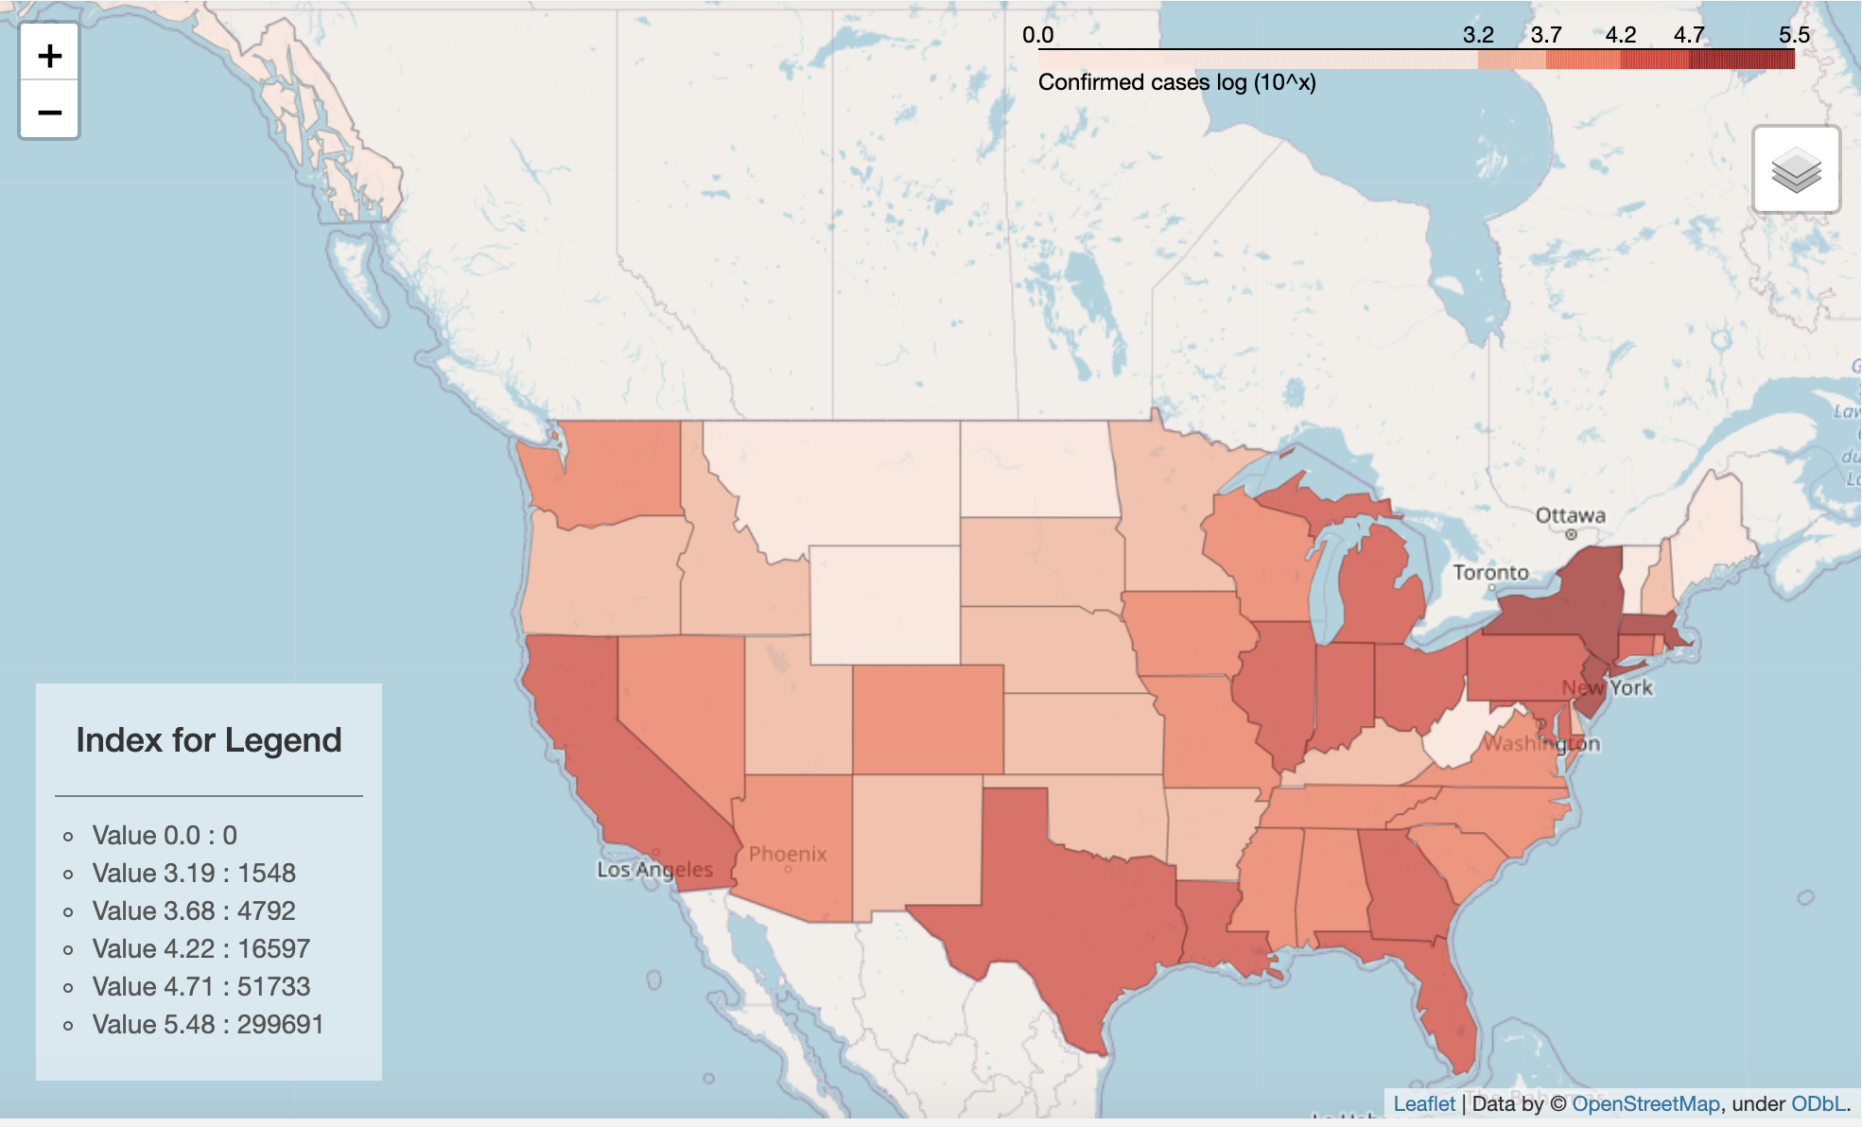
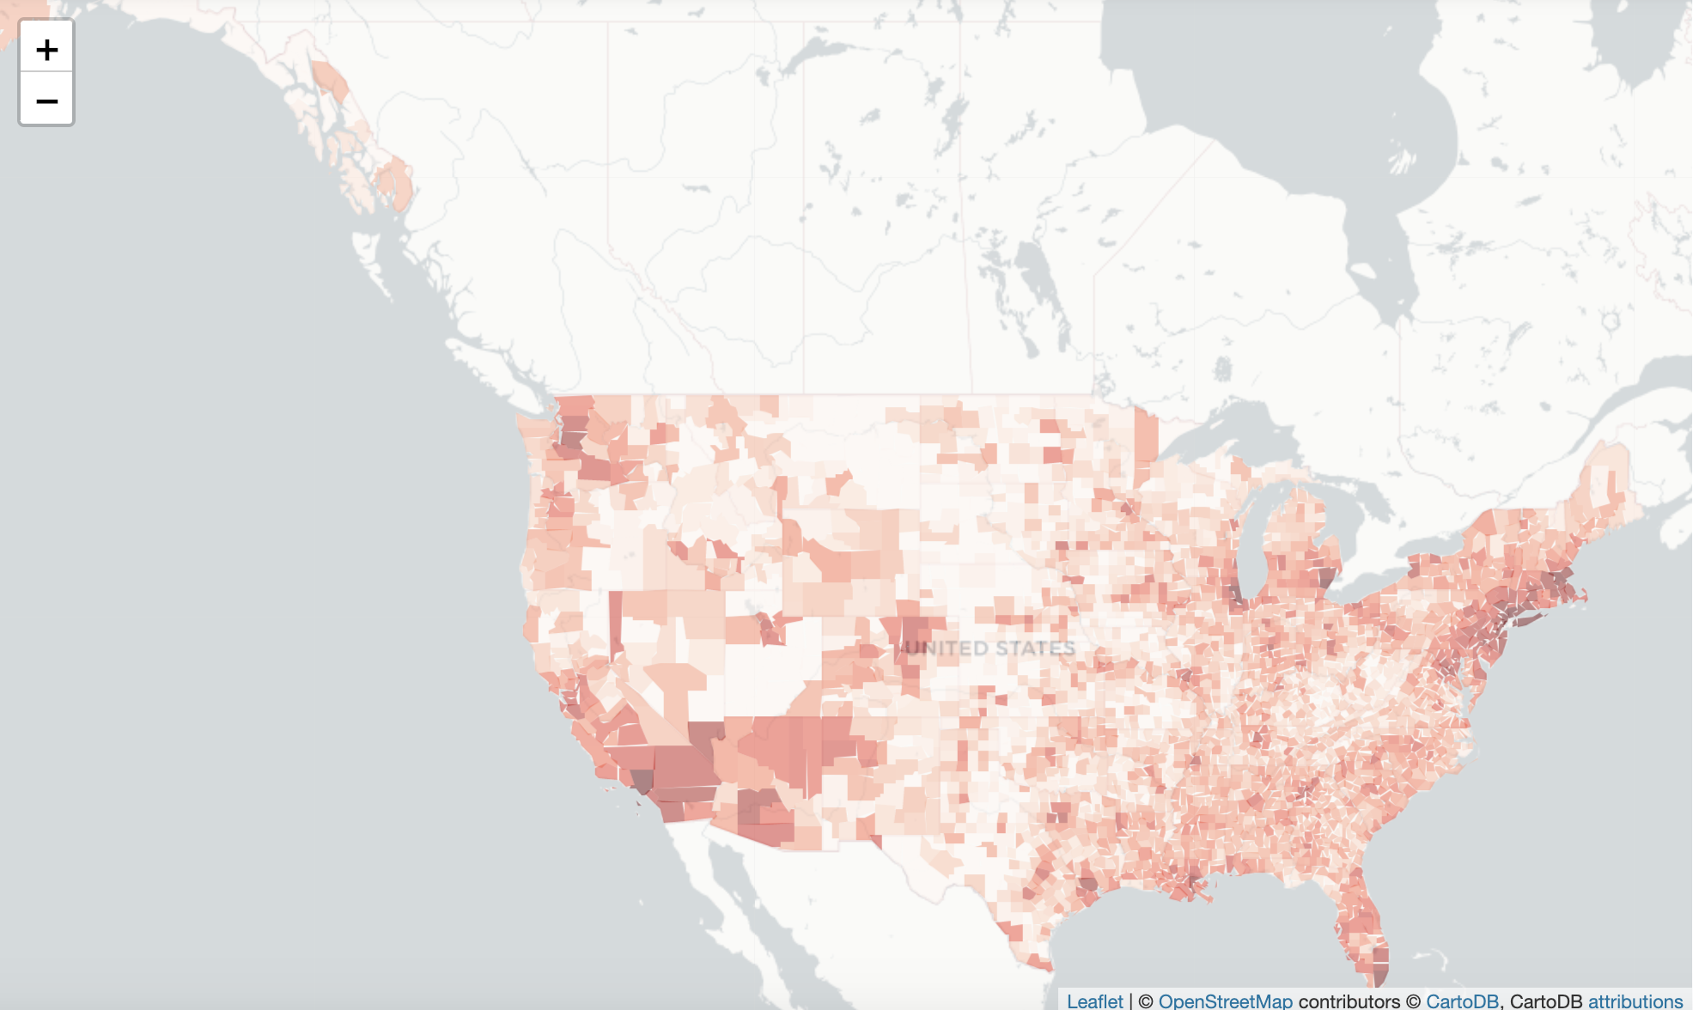
Heatmap of Confirmed Cases in the United States

Slide 6
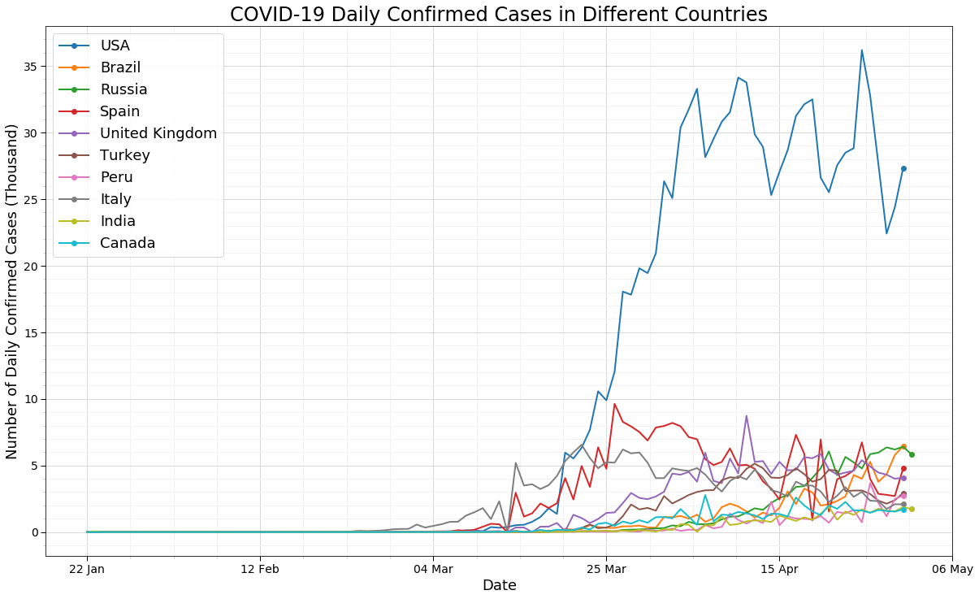
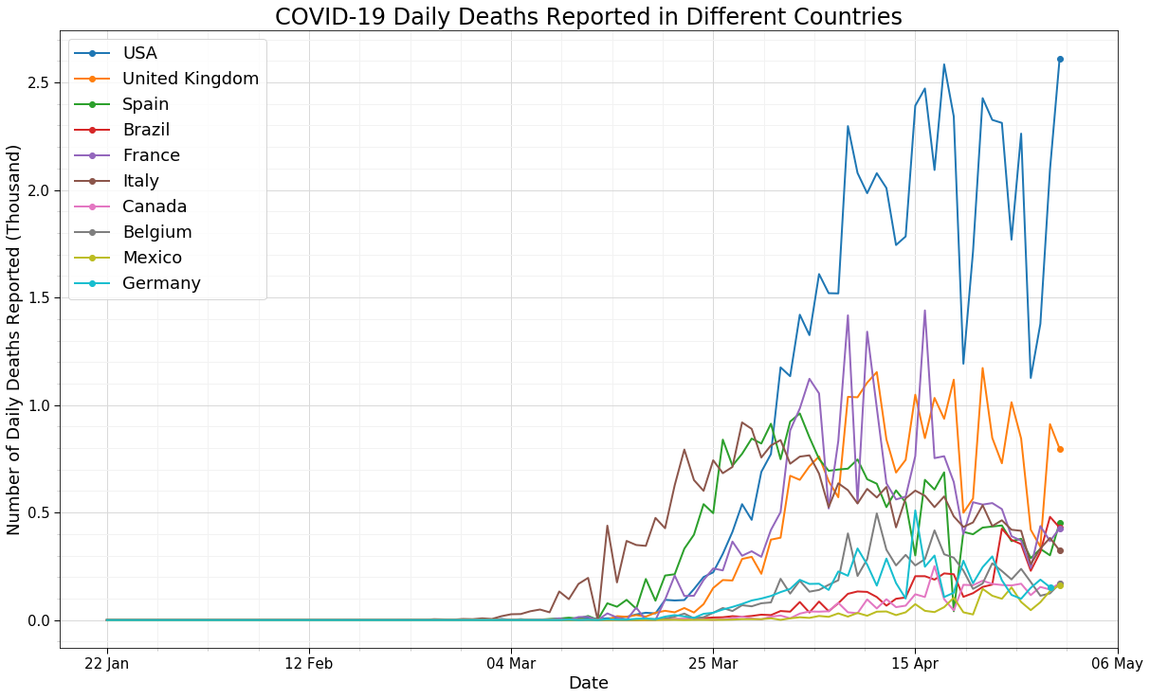
Developing Trend of Covid-19

Slide 7
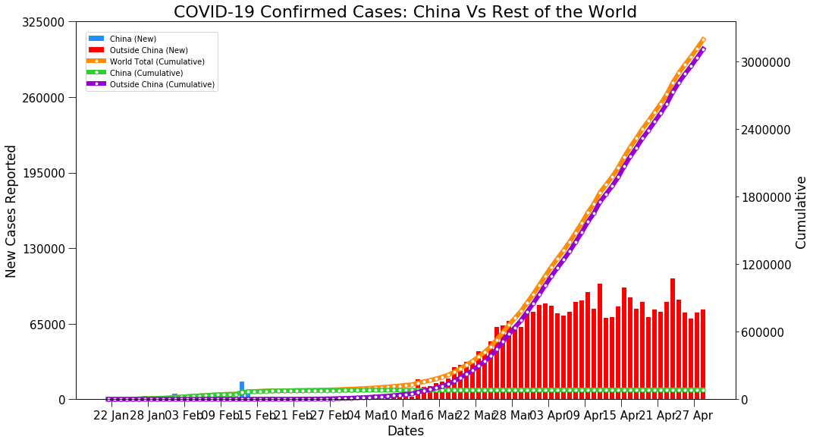
Cases in/outside China

Slide 8
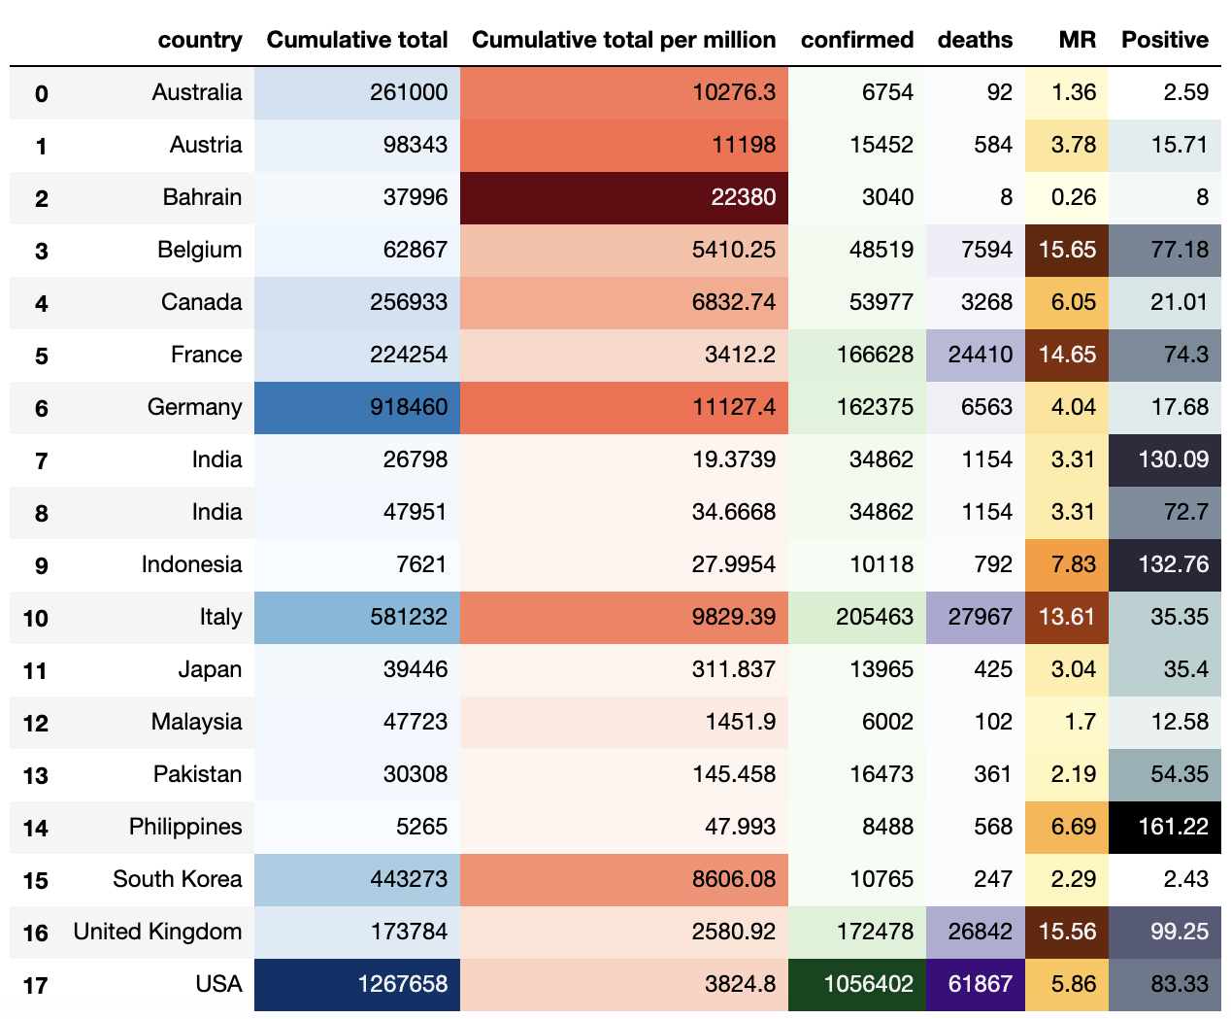
Analysis of Countries’ Testing Ability

Slide 9
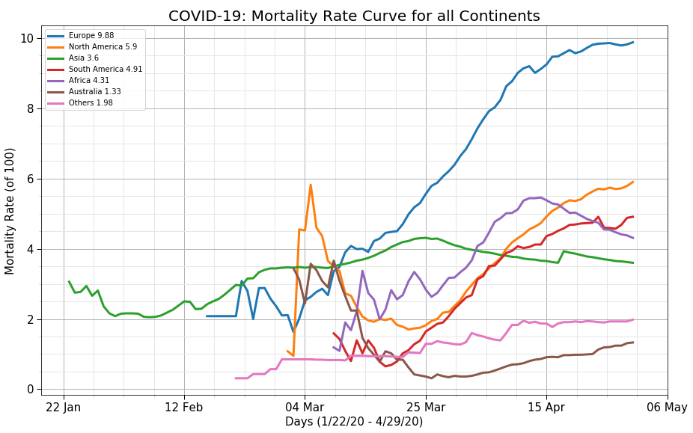
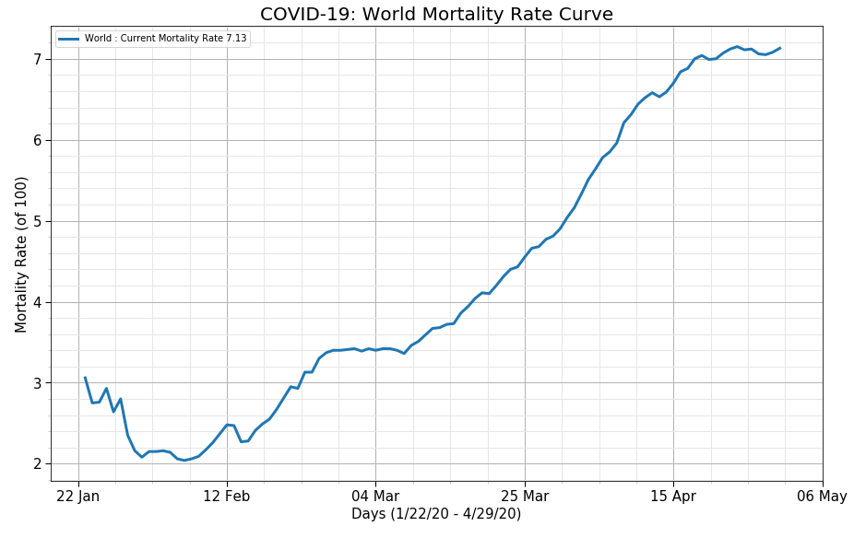
Covid-19 Mortality Rate

Slide 10
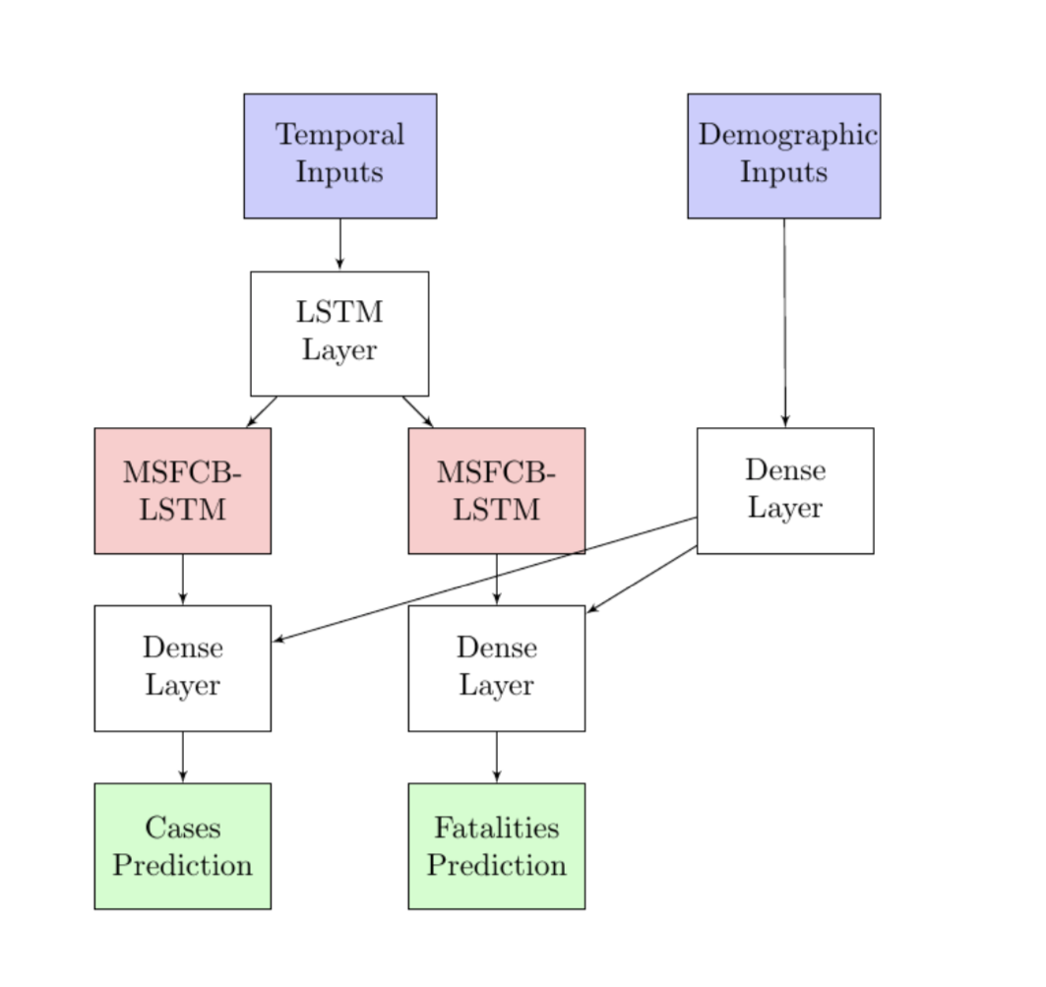
Using Hybrid Deep Learning Model to Predict
Temporal Features (In the past 13 days):
Number of confirmed cases
Number of fatalities
Restrictions applied or not
Quarantine applied or not
Schools opened or closed
Atemporal Features:
Population of each country
Density of each country
Number of hospital beds of each country
Lung measurement of female and male in each country
Model Output:
Number of confirmed cases for the 14th day
Number of fatalities for the 14th day
Multi-Stacked Fully Connected Bidirectional-Long Short Term Memory

Slide 11
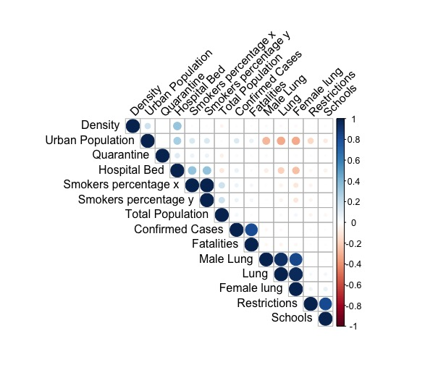
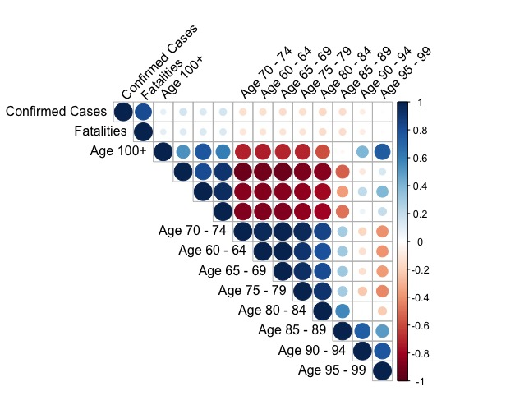
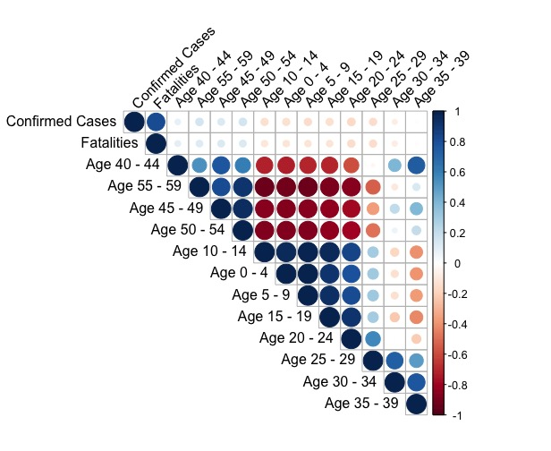
Data Preprocessing, Correlation Analysis
Correlation among Confirmed cases, fatalities, and percentage of the population with ages larger than 60 years old
Correlation among Confirmed cases, fatalities, and percentage of the population with ages 0-59 years old
Correlation among Confirmed cases, fatalities and other features

Slide 12
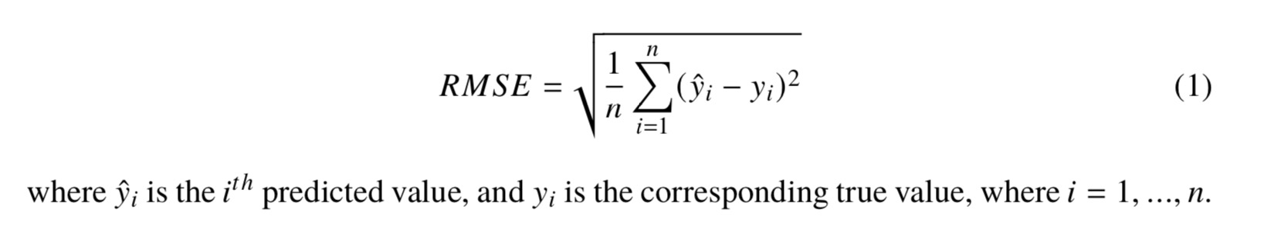
Model Evaluation
To evaluate the accuracy of the model:

Slide 13
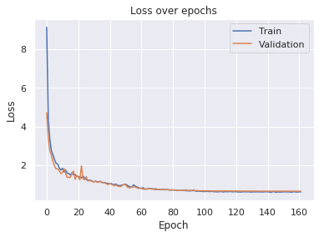
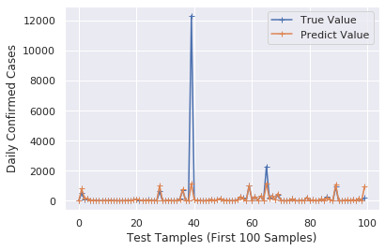
Confirmed Cases Prediction

Slide 14
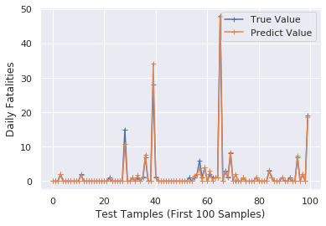
Fatalities Prediction

Slide 15
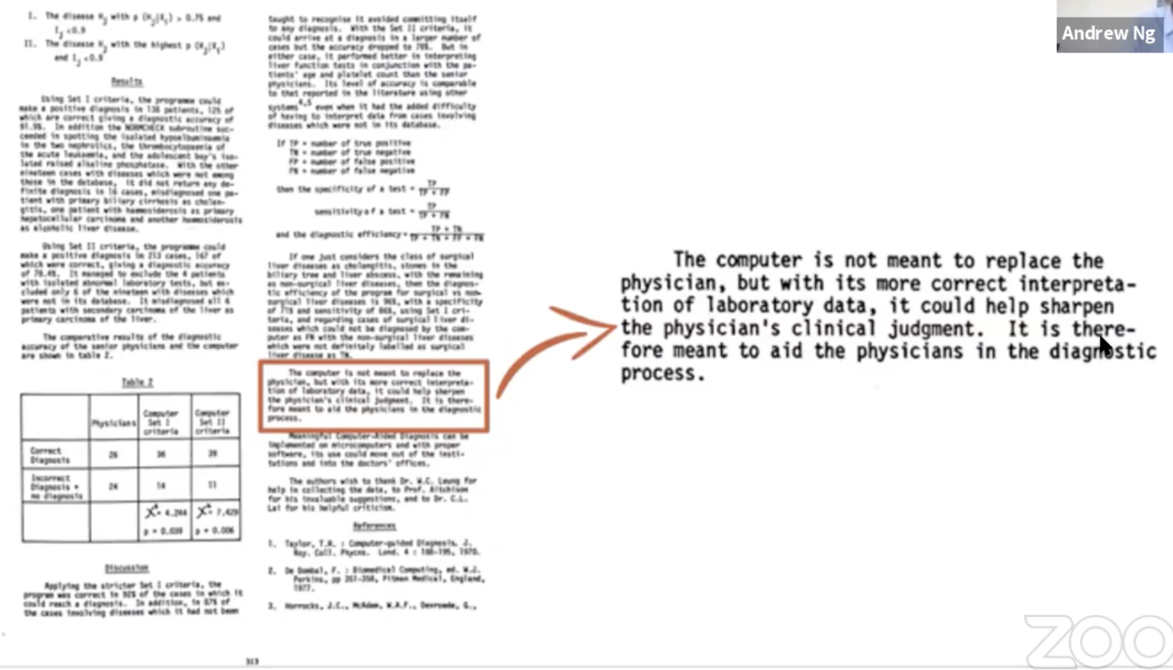
Thoughts
Whether deep learning can be used for disease prediction? (Compared with SIR/SEIR…
How can it be applied?
Flatten the curve/ End the curve?

